Slide 1
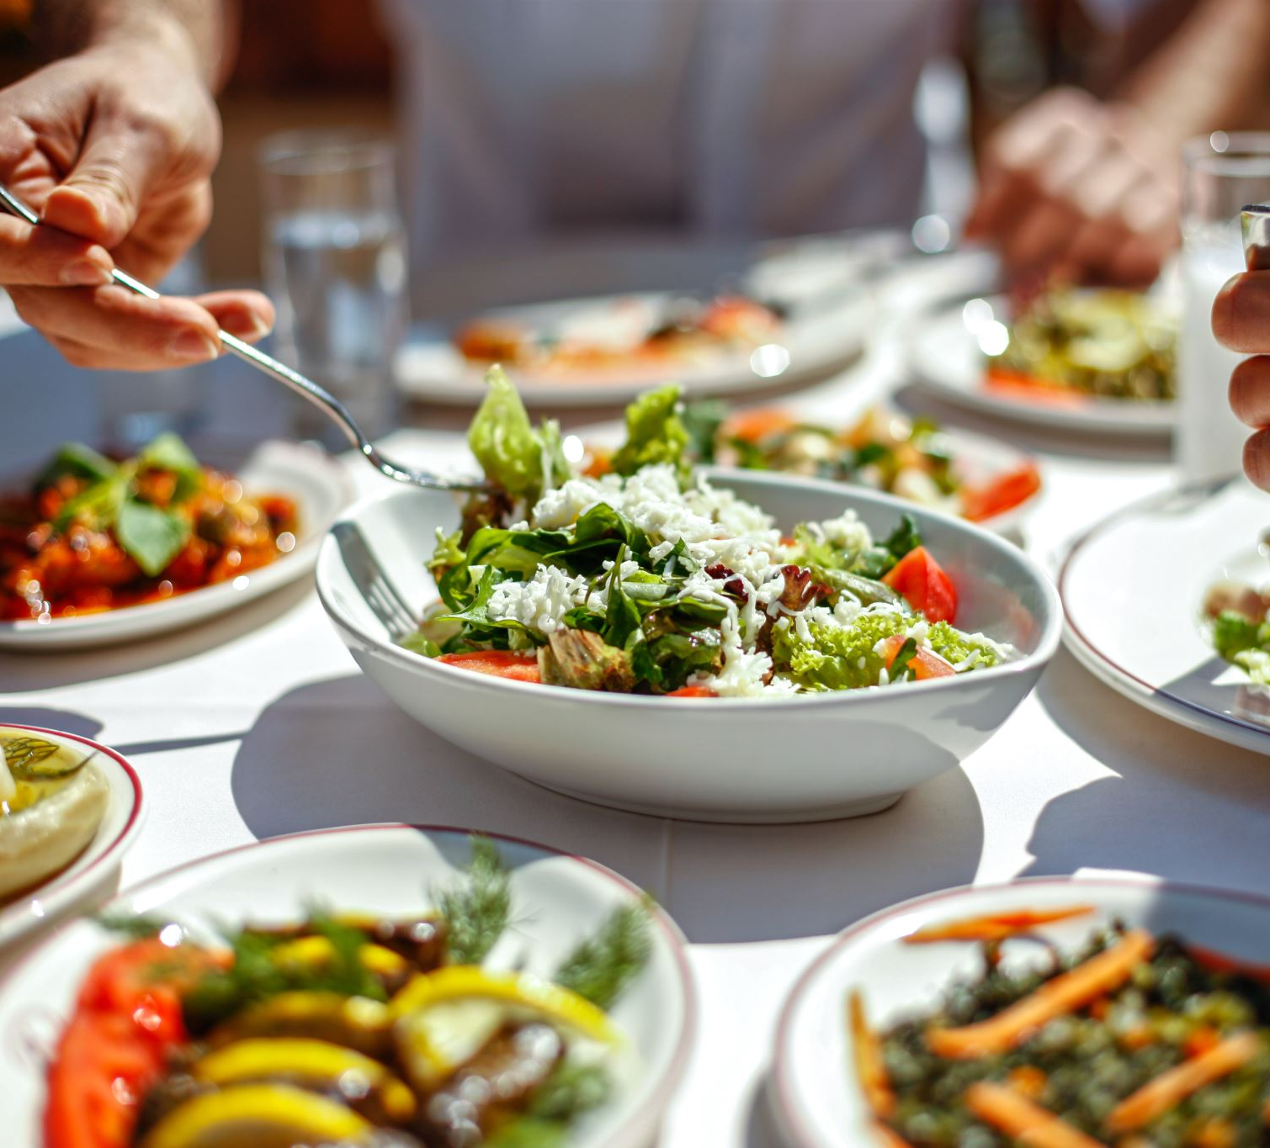
Bangalore Restaurants
Done by : Aml Kamal
Supervised by : Eng / Abdelrahman Gaber

Slide 2
Bangalore has a vibrant and diverse culinary scene. You can find restaurants offering a wide range of cuisines, from traditional South Indian dishes to international options like Italian, Chinese, and Continental.
The city hosts various food festivals and events throughout the year, showcasing different cuisines and culinary experiences.
Bangalore has at approximately 12,000 restaurants. With such an high number of restaurants.

Slide 3
Project Workflow
Data Collection
Data Preprocessing.
Exploratory Data Analysis (EDA).
NLP.
Data preparing for machine learning model
Data Analysis.
Dashboard using Streamlit

Slide 4
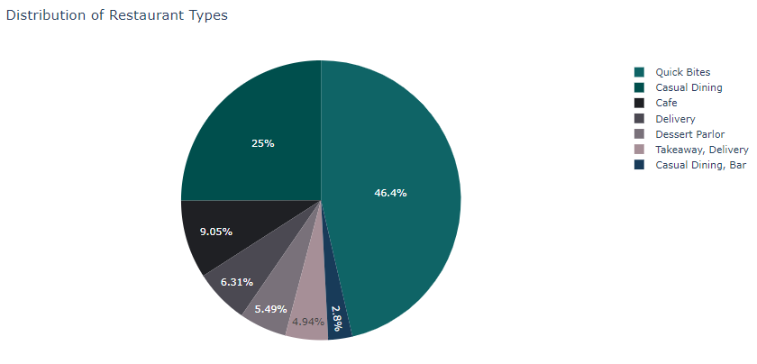
The most popular restaurant type

Slide 5
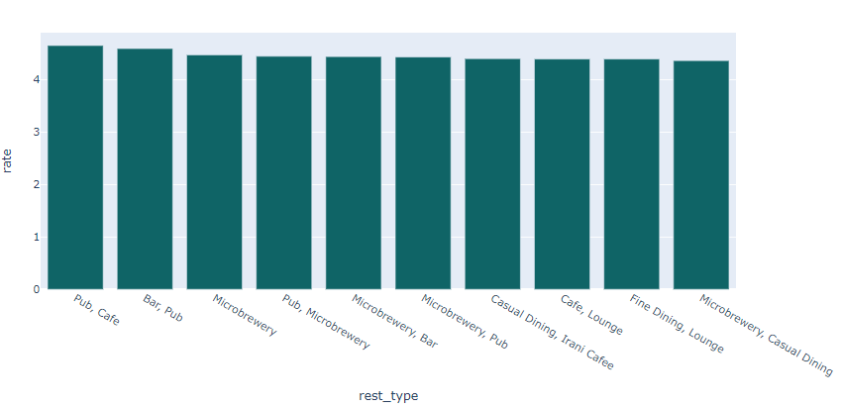
Highest rated restaurant type

Slide 6
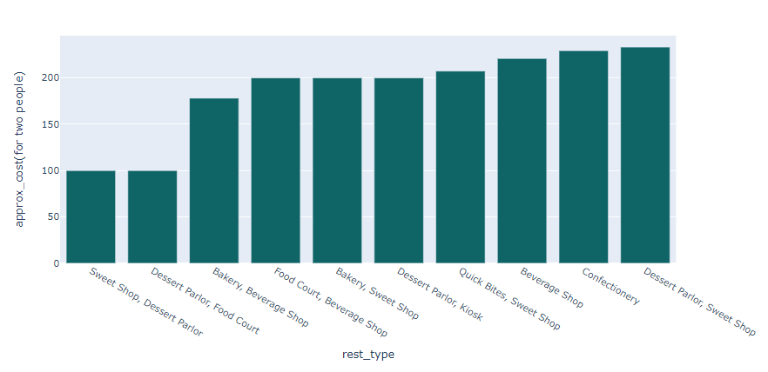
Restaurants types that offer the best cost of two person

Slide 7
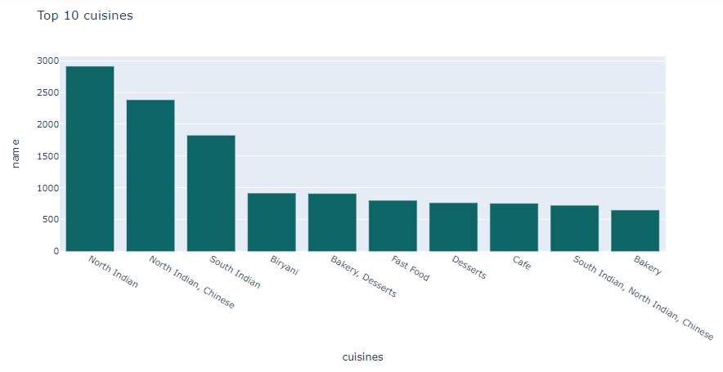
The most popular cuisines

Slide 8
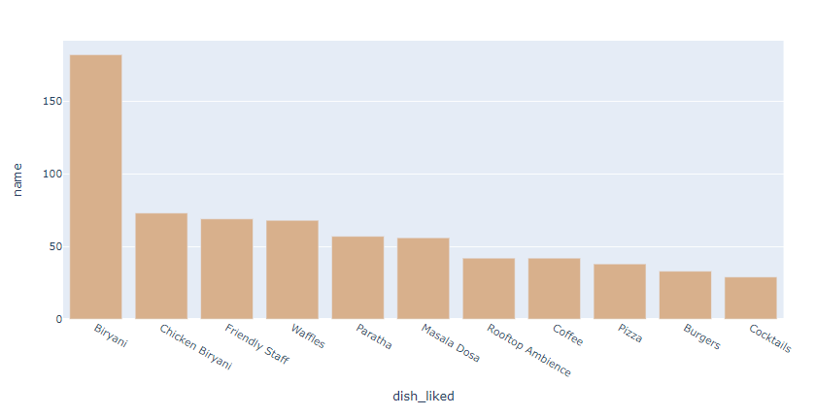
The most dish_liked

Slide 9
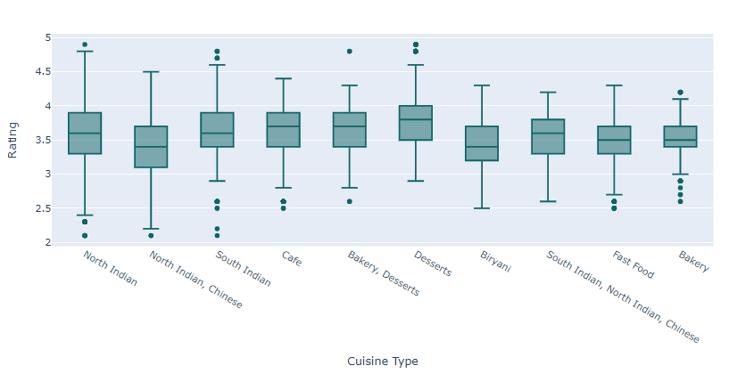
Highly rated cuisines

Slide 10
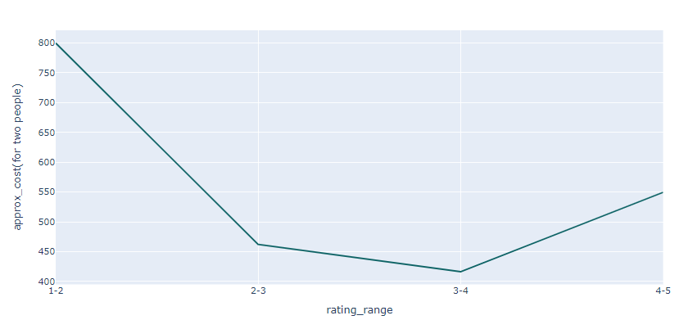
Rating according to the cost

Slide 11
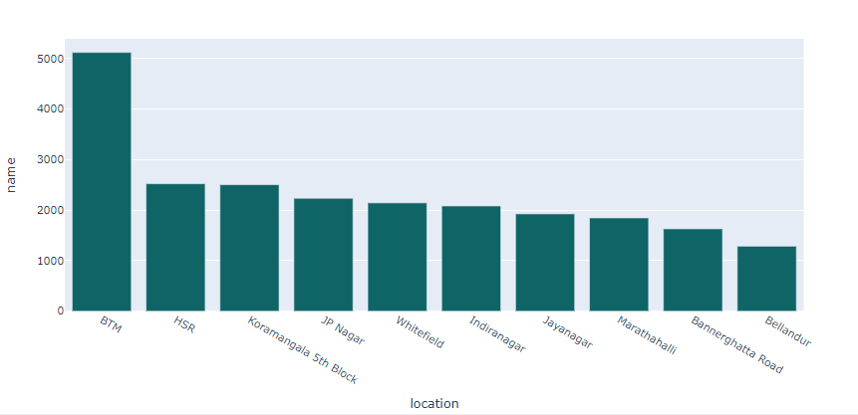
Number of restaurant in each neighborhood

Slide 12
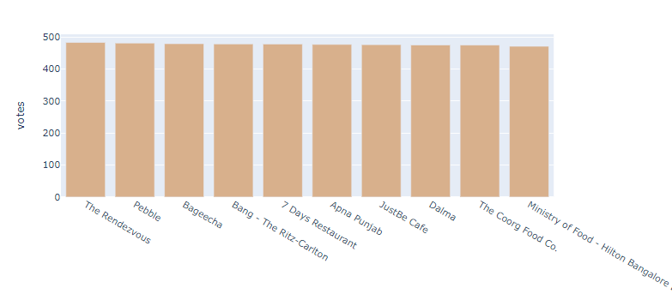
The highest restaurants are voted and recommended

Slide 13
Recommendation
Culinary and Cultural Experience:
To attract more visitors to neighborhoods like BTM Layout, focus on creating a unique culinary and cultural experience. Invest in marketing to highlight the area's distinctive offerings.
Enhance Services:
Provide all restaurants with essential services such as online ordering and table booking to cater to modern customer preferences and convenience.
Cuisine Evolution Analysis:
Analyze the transformation of Bengaluru's dining scene over the years to spot emerging food trends and changing customer preferences.
Quality-Cost Balance:
Ensure a balance between quality and cost in the restaurant offerings to attract a diverse range of customers.

Slide 14
Seasonal Dining Insights:
Investigate seasonal dining trends, unveiling variations in customer behavior during festivals and specific times of the year. Utilize these insights for targeted promotions and menus.
Dish Popularity Exploration:
Explore the most beloved dishes among customers, studying variations in praise and preferences across different cuisine types to fine-tune menus and offerings.

